Slide 1
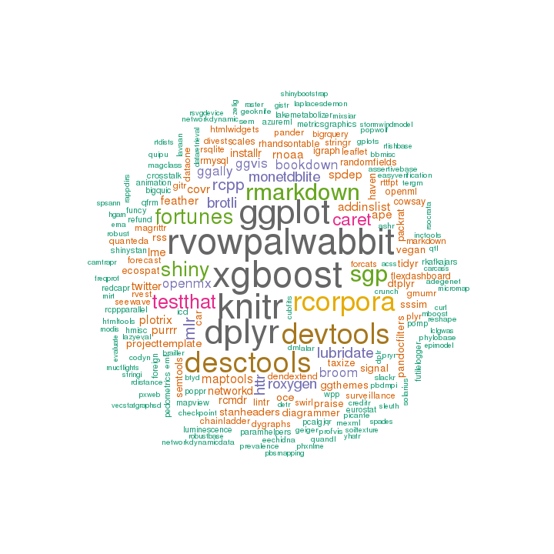

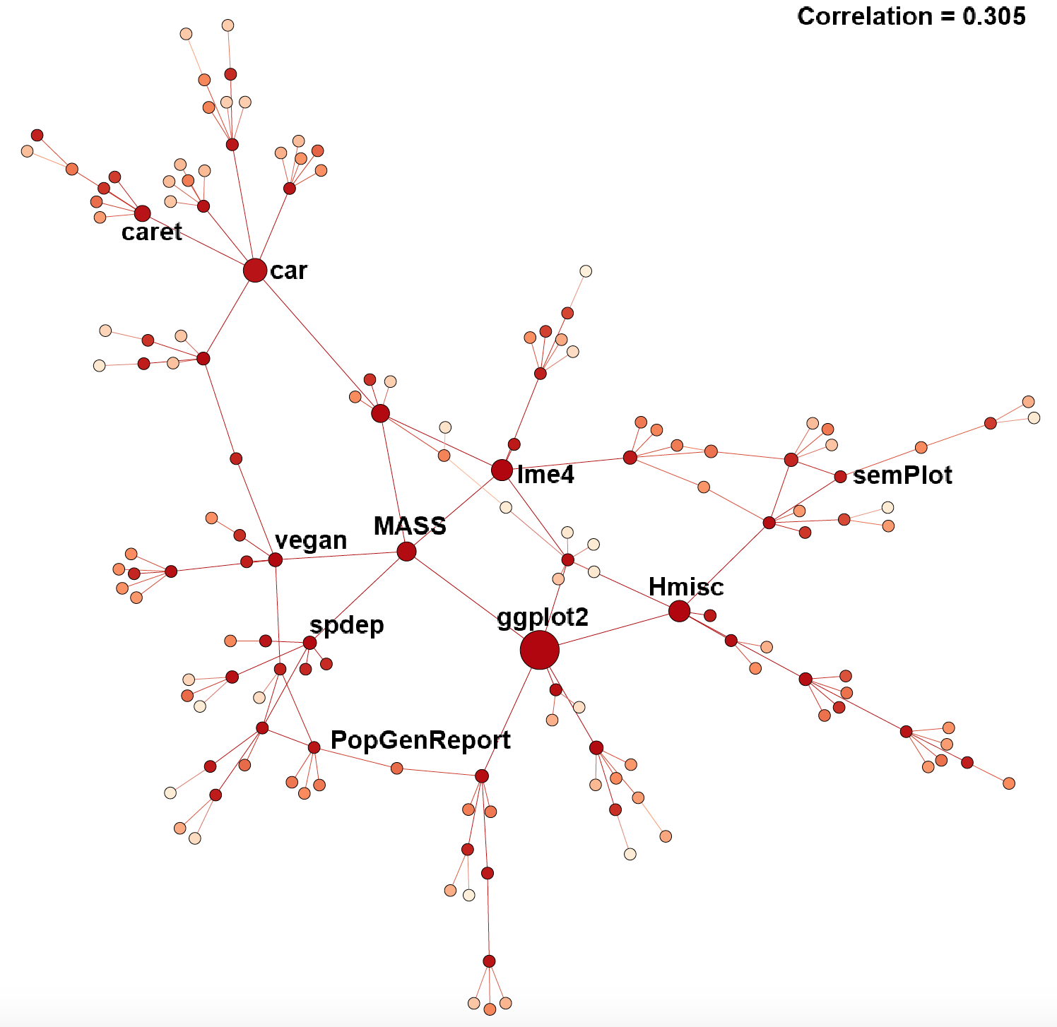
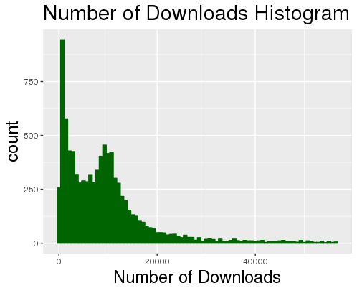
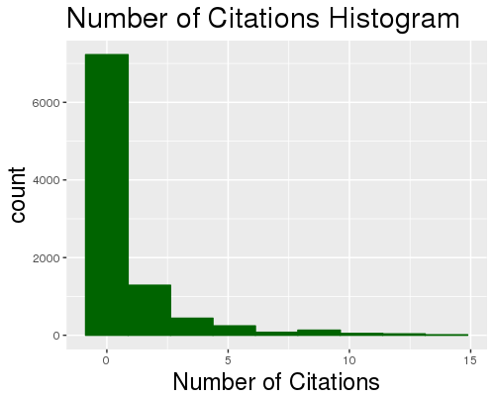

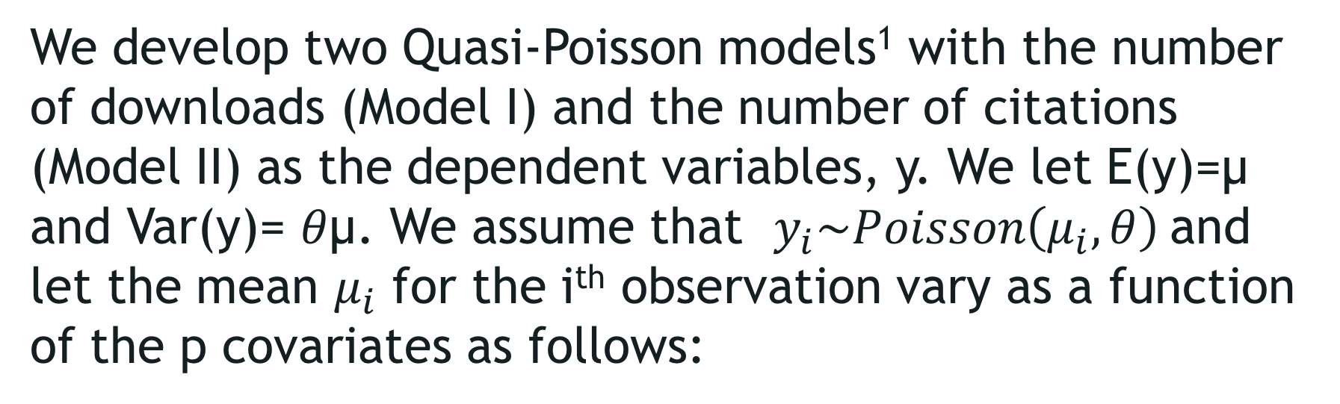
Modeling the impact of open source
SOFTWARE: A STUDY OF r PACKAGES
Ronnie Fecso (VT), Claire Kelling (PSU) with Gizem Korkmaz and Stephanie Shipp (SDAL)
Sponsor: Carol Robbins, The National Center for Science & Engineering Statistics at NSF
Research Question
This project aims to identify the factors that affect the impact of Open Source Software (OSS), measured by the number of downloads and citations, with a case study of R packages. We generate the dependency network of the packages collected from Depsy.org, and develop statistical models that use the network characteristics and the package attributes.
Background: The programming language R was created in 2000 by two professors at the University of Auckland for their statistics students. It is one of the fastest growing programming languages due to low barriers to entry. It is widely used for data analysis, visualization, and statistical modeling.
Data Source: Depsy.org
Depsy.org, initially NSF-funded, is a website that compiles R and Python packages to quantify coding impact in the scientific community. It includes detailed information such as contributors, commits, downloads, citations, and stars (identifying active development).
R Packages by #contributors
Tags on Depsy.org
There are 34 tags on Depsy
Average number of tags per package: 1.3
Average number of packages per tag: 90.8
2,429 packages (25%) have tags
Data Collection Process:
Gathered all of the R packages listed on CRAN (10,926 packages listed as of July 11th, 2017)
Scraped the characteristics from the JSON page affiliated with each R package from Depsy
9,810 of these packages (90%) were on Depsy (last update in Sept. 2015) with 24,000+ affiliated contributors
Measuring Impact: Downloads and Citations
The Network of R Packages
Top Downloaded Packages | Number of Downloads
Rcpp | 6,683,565
ggplot2 | 6,255,500
stringr | 5,366,703
plyr | 5,345,308
digest | 5,251,824
Top Cited Packages | Number of Citations
vegan | 4,275
lme4 | 4,023
nlme | 2,916
ggplot2 | 1,702
gplots | 1,307
We generate the dependency network of R packages where a directed edge i → j indicates that the package j requires i to be installed to function. The figure below uses a subgraph (starting at MASS as the root node) with 149 nodes for illustrative purposes.
Full Network Characteristics:
7,389 nodes
20,235 directed edges
Average indegree = outdegree = 2.74
56 weakly connected components
largest component has 7,261 packages
Remaining components include 2 to 4 packages (mean 2.33)
Size of the node represents the number of downloads
The distribution of the number of downloads is skewed and bimodal. The average number of downloads is ~58K, and the average number of citations is ~6.84 per package.
The Model & Findings
We develop two Quasi-Poisson models¹ with the number of downloads (Model I) and the number of citations (Model II) as the dependent variables, y. We let E(y)=µ and Var(y)= $θ$µ. We assume that $y_{i}\sim Poisson\left(μ_{i},θ\right)$and let the mean $μ_{i}$ for the i^{th} observation vary as a function of the p covariates as follows:
The findings are summarized in the table below.
We find that the network centrality of a package (the number of packages that depend on it, and how they are connected) as well as package attributes (e.g., the number of contributors, the number of commits) are important factors in showing the impact of open source software, measured by the number of downloads and the number of citations.
$$μ_{i}=exp⁡(β_{0}+β_{1}x_{1,i}+…+β_{p}x_{p,i})$$
where the network characteristics and the package attributes are used as covariates.
Future Work
Significance codes: 0 (***), 0.001 (**), 0.01 (**), not significant (-)
Develop methods to measure the cost and the economic impact of OSS projects.
Apply similar methods to measure the impact of Python packages.
Definitions: Outdegree (indegree, resp.) is the total number of outgoing (incoming) links. Closeness centrality measures how close a node is to every other node. Betweenness is a measure of being connected to other nodes that are not connected to each other (as a bridge). Eigencentrality of a node takes into account the centrality of its neighbors. PageRank depends on (i) the number of links the node receives, (ii) the number of links given out by its neighbors, (iii) the centrality of its neighbors. Clustering coefficient quantifies the degree to which a node’s neighbors are connected. Authority measures the value of information stored at the node; hub measures the quality of its links. Eccentricity captures the node’s distance from the furthest node. Modularity is how the network decomposes into subnetworks.
[1] Ver Hoef, J. M. and Boveng, P. L. (2007), Quasi-Poisson vs Negative Binomial Regression: How Should We Model Overdispersed Count Data?. Ecology, 88: 2766–2772. doi:10.1890/07-0043.1

